Slide 1

Corporate Overview
 | 2015 | 2016 | 2017 | 2018
Revenue (£m) | 367 | 391 | 411 | 438
Group Surplus (£m) | 55.5 | 62.5 | 74.4 | 92.9
Surplus % | 15.12% | 15.98% | 18.10% | 21.21%
Saul Nassé
Group CEO
Cambridge Assessment is a not-for-profit non-teaching department of the University of Cambridge. It provides education assessments for over 8 million learners in over 170 countries and marked by over 30,000 examiners every year. Comprises of 3 exam boards -
Cambridge Assessment English (CAE) provides the world’s leading range of qualifications for learners and teachers of English. CAE works in more than 130 countries. Over five million people every year take its exams, which are recognised by over 24,000 universities, employers and governments.
Cambridge Assessment International Education (CIE) prepares school students for life. More than 10,000 schools in 160 countries are part of the Cambridge learning community and Cambridge International is a trusted partner for governments in over 30 countries.
OCR (Oxford Cambridge and RSA Examinations) is one of the UK’s leading exam boards, providing a wide range of general and vocational qualifications to equip learners aged 14 to 19 and beyond with the knowledge and skills they need to achieve their full potential. Each year, students achieve around one million OCR qualifications at 8,000 centres including schools, sixth form and further education colleges and training providers.
£ 239.15 m
Revenue share: 54.6%
CAE
£ 141.91 m
Revenue share: 32.4%
CIE
£ 56.94 m
Revenue share: 13%
OCR
CEO
Francesca Woodward
CEO
Christine Özden
CEO
Jill Duffy
Stephen Brodigan (CTO)
David Bulman (CIO)

Slide 2
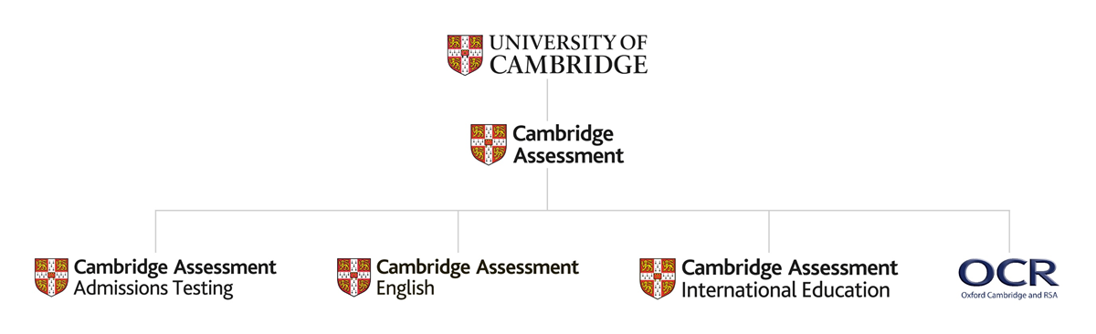
Business Units

Slide 3
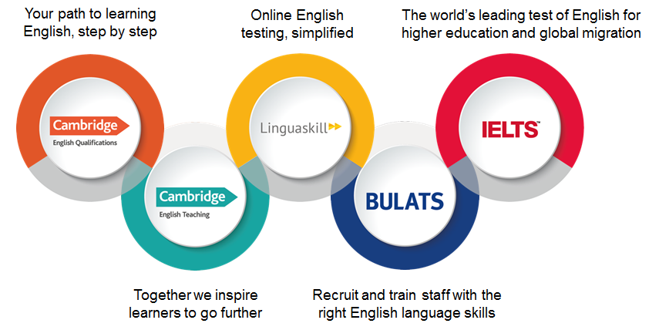
Cambridge Assessment English

Slide 4
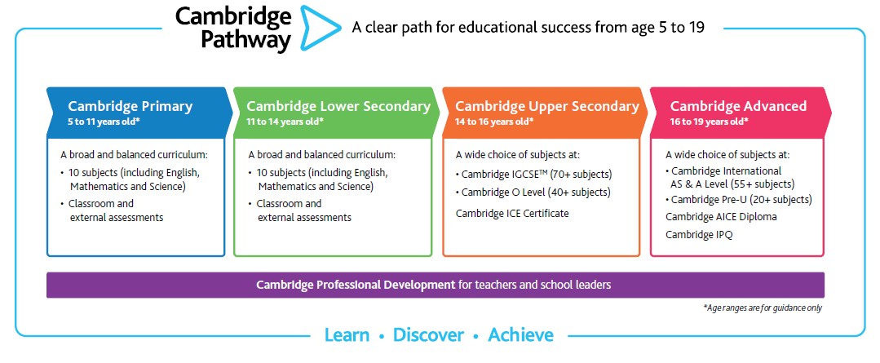
Cambridge Assessment International Education

Slide 5
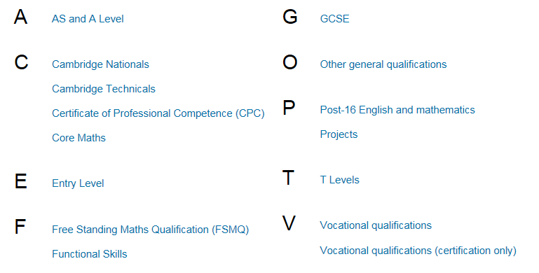
OCR

Slide 6
Cambridge Assessment Admission Testing
BioMedical Admissions Test (BMAT)
Cambridge Test of Mathematics for University Admission (CTMUA)
University of Cambridge pre-interview assessments
University of Oxford admissions tests
International Medical Admissions Test (IMAT)
Mathematics Admissions Test (MAT)
Sixth Term Examination Paper (STEP)
Test of Mathematics for University Admission
Thinking Skills Assessment (TSA)
Cambridge Personal Styles Questionnaire® (CPSQ)

Slide 7
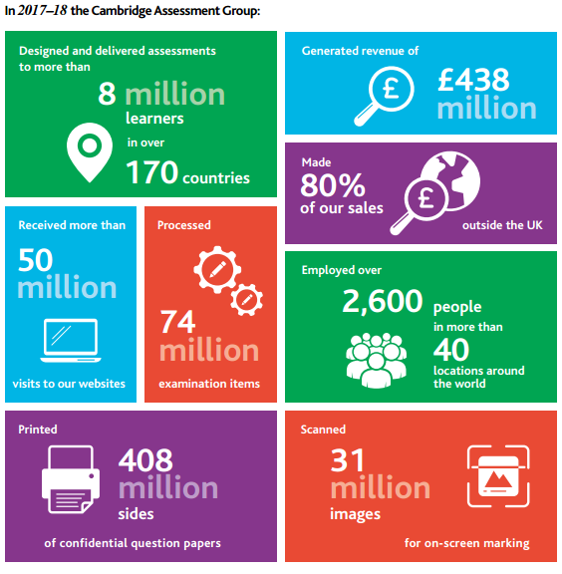
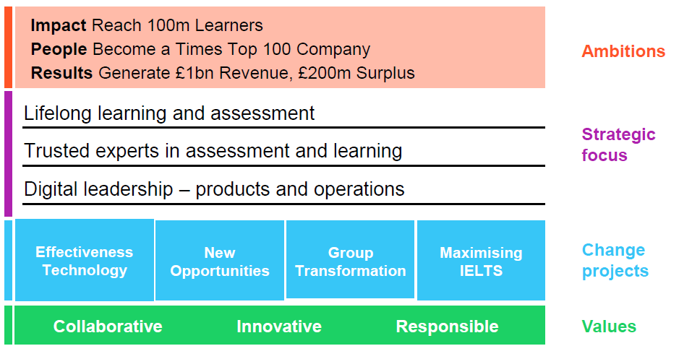
Business Highlights and Priorities
Key Stats:
Client priorities:

